Slide 1
Project 3: An Introduction to File Systems
CS3430
Operating Systems
University of Northern Iowa

Slide 2
Introduction
The goal of project 3 is to understand
  basic file system design and implementation
  file system testing
  data serialization/de-serialization
At the end of the project, you will feel like a file system expert!

Slide 3
Outline
Background
  Mounting file systems
Project 3
  Specification
  Downloading and testing file system image
  General FAT32 data structures
  Endian-ness

Slide 4
Mounting File Systems

Slide 5
Unix File Hierarchy
All files accessible in a Unix system are arranged in one big tree
  Also called the file hierarchy
  Tree is rooted (starts) at /
These files can be spread out over several devices
The mount command serves to attach the file system found on some device to the big file tree

Slide 6
‘mount’ command
mount
mount <device> <mount directory>
Typing ‘mount’ without arguments shows you what is mounted and where
Second example attaches a device or partition to a directory
  Must have root privileges

Slide 7

Mount Example
Mount point
/dev/sda1
The device sda partition 1 is mounted at “/”. All files and dirs below “/” come from this device.

Slide 8
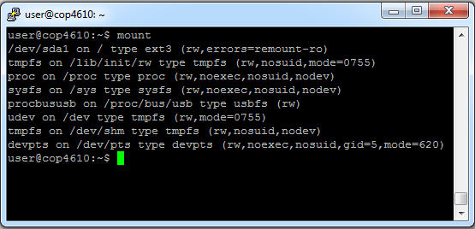
Mount Example
Type command ‘mount’ without any arguments to see what is mounted and where
Root “/” file system mounted

Slide 9

Mount Example
/dev/sda1
Now suppose we attach a thumb drive and want our thumb drive files accessible under /mnt…
/dev/sdb1

Slide 10
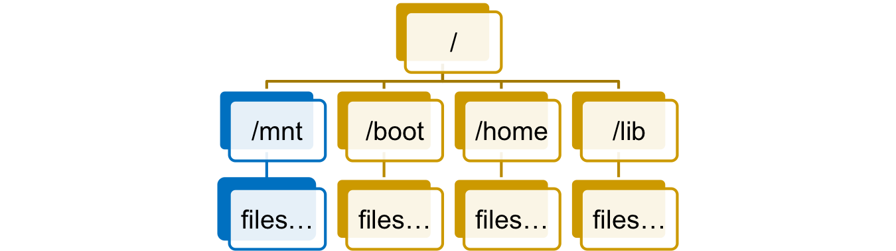
File Hierarchy Example
Mount point
/dev/sda1
Files from the thumb drive are now accessible under /mnt
/dev/sdb1

Slide 11
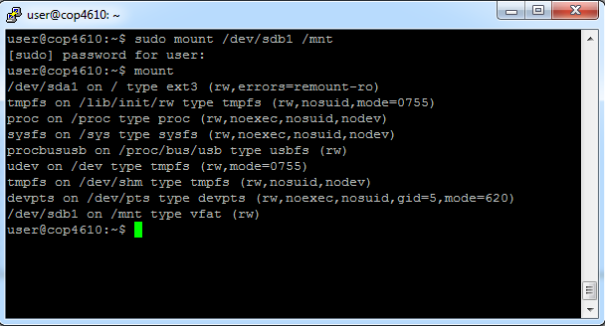
Mount Example
The ‘mount’ command can dynamically attach new devices to new mount points

Slide 12
Mount Example
The ‘mount’ command can dynamically attach new devices to new mount points
Thumb drive mounted here

Slide 13
Un-mount Command
umount <dir>
In our example where the thumb drive was mounted at /mnt, we can issue
  $> umount /mnt
  Must have root privileges
    This means you can play with the mount command on your virtual machine, but not on the class server

Slide 14
Loopback File Systems
A loopback file system is an image of a complete file system within a single file
All the sector contents are concatenated in order within the file (one big char array).
Linux can mount one of these like any other filesystem.
mount -o loop disk1.iso /mnt/disk
You will use one of these for your project
You will NOT be mounting it!!

Slide 15
Figuring out names of devices
/etc/fstab – Has list of devices and file systems that get auto-mounted on boot
‘dmesg’ command shows output when plugging in a dynamic device

Slide 16
Project 3
More than you wanted to know about FAT32..

Slide 17
Project 3
You will create a user-space utility to manipulate a FAT32 file system image
  No more kernel programming!
Utility must understand a few basic commands to allow simple file system manipulation
Utility must not corrupt the file system and should be robust

Slide 18
FAT32 Manipulation Utility
Utility only recognizes the following built-in read-only commands:
info
open
close
size
cd
ls
read

Slide 19
File System Image
Manipulation utility will work on a pre-configured FAT32 file system image
  Actually a file
File system image will have raw FAT32 data structures inside
  Just like looking at the raw bytes inside of a disk partition

Slide 20
File System Image
Your FAT32 manipulation utility will have to
  Open the FAT32 file system image
  Read parts of the FAT32 file system image and interpret the raw bytes inside to service your utility’s file system commands…
…just like a file system!

Slide 21
General FAT32 Data Structures

Slide 22
Terminology
Byte – 8 bits of data, the smallest addressable unit in modern processors
Sector – Smallest addressable unit on a storage device. Usually this is 512 bytes
Cluster – FAT32-specific term. A group of sectors representing a chunk of data. Usually called a block.
FAT – Stands for file allocation table and is a map of files to data

Slide 23
FAT32 Disk Layout
3 main regions…
Reserved
Region
FAT
Region
Data
Region
Track
Disk arm
Sector

Slide 24
Reserved Region
Reserved Region – Includes the boot sector, the extended boot sector, the file system information sector, and a few other reserved sectors
Reserved
Region
FAT
Region
Data
Region
Boot Sector | FS Information Sector | Additional Reserved Sectors (Optional)

Slide 25
FAT Region
FAT Region – A map used to traverse the data region. Contains mappings from cluster locations to cluster locations
Reserved
Region
FAT
Region
Data
Region
File Allocation Table #1 | Copy of File Allocation Table #1

Slide 26
Data Region
Data Region – Using the addresses from the FAT region, contains actual file/directory data
Reserved
Region
FAT
Region
Data
Region
Data until end of partition

Slide 27
Endian
Big or little?

Slide 28
Machine Endianness
The endianness of a given machine determines in what order a group of bytes are handled (ints, shorts, long longs)
  Big-endian – most significant byte first
  Little-endian – least significant byte first
This is important to understand for this project, since FAT32 is always formatted as little-endian

Slide 29
FAT32 Endianness
The following are a few cases where endianness matters in your project:
  Reading in integral values from the FAT32 image
  Reading in shorts from a FAT32 image
  Combining multiple shorts to form a single integer from the FAT32 image
  Interpreting directory entry attributes

Slide 30
Endian Example (English Version)
Imagine you can only communicate three letters at a time, and your word is “RAPID”
Big-endian
  1. RAP
  2. ID
  Word = RAPID
Little-endian
  1. PID
  2. RA
  Word = PIDRA (come again?)

Slide 31
Endian Example (data version)
short value = 15; /* 0x000F */
char bytes[2];
memcpy(bytes, &value, sizeof(short));
In little-endian:
  bytes[0] = 0x0F
  bytes[1] = 0x00
In big-endian:
  bytes[0] = 0x00
  bytes[1] = 0x0F

Slide 32
Endian Example (data version 2)
int value = 13371337; /* 0x00CC07C9 */
char bytes[4];
memcpy(bytes, &value, sizeof(int));
In little-endian:
  bytes[0] = 0xC9
  bytes[1] = 0x07
  bytes[2] = 0xCC
  bytes[3] = 0x00
In big-endian:
  bytes[0] = 0x00
  bytes[1] = 0xCC
  bytes[2] = 0x07
  bytes[3] = 0x09

Slide 33
Visualizing Endianness
Value = 13371337 (0x00CC07C9)
index | 0 | 1 | 2 | 3
little endian | 0xC9 | 0x07 | 0xCC | 0x00
big endian | 0x00 | 0xCC | 0x07 | 0xC9

Slide 34
Helper Resources and Programs
Review how to do file I/O in C
  Will have to read and seek around in the image file.
  Or, you can use memory mapped files (any language)
Review how to run Python 3 and Java programs on a Linux server
  If your project does not compile or run on Linux, the most it can earn is 50%
  Install Java i8+ and/or Python 3 as needed
  Python 2 does not count!!
Parameter passing program
  In C, but other languages are very similar

Slide 35
Additional Project 3 Information
May work in pairs or alone
First phase due on April 13
Project deadline is April 20.

Slide 36
Next Steps
Take a look at the fat32 specification file from Microsoft
  Somewhat confusing – just like the real world
Take a look at the image file
  You may mount it in Linux, but that doesn't contribute to your project

